Slide 1
Introduction
Pointing poker (planning poker) is a application to estimate effort or relative size of development goals in software development.
Team
Kovbenya Alexander (Tram Lead)
Dostovalov Alexander
VladislavHo
Anastasia Leanovich – Mentor

Slide 2
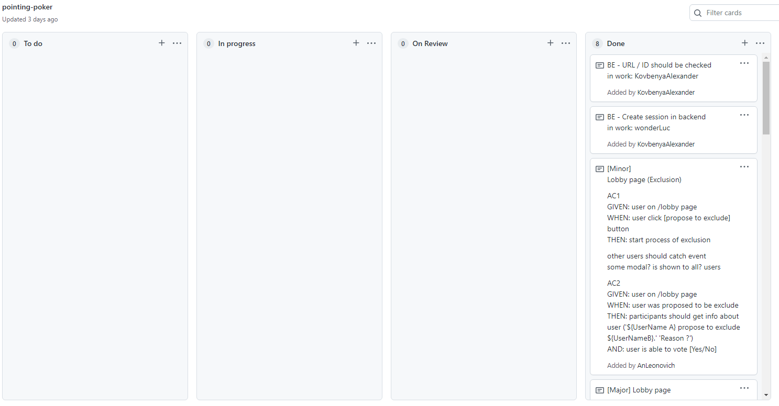
Workflow organization
Weekly meetings
Defining goals
Distribution of tasks
Conflicts resolved through discussion. If no solution is found, the decision is made by the leader

Slide 3
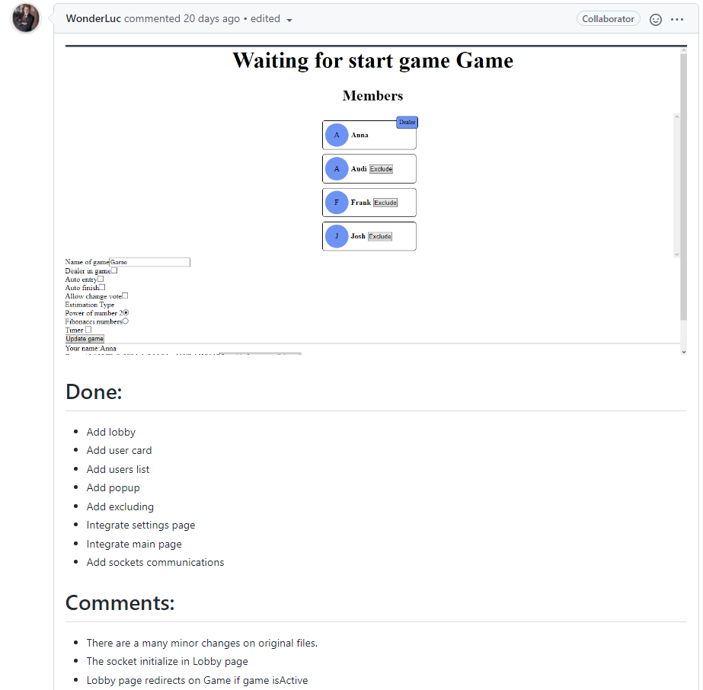
Pull Requests
If at least two developers have approved a pr, then the pr available to merge
PR example

Slide 4
Dependencies
BackEnd
FrontEnd
axios
react
react-copy-to-clipboard
react-redux
react-router
redux
redux-devtools-extension
redux-thunk
socket.io-client
uuid
cors
express
socket.io
uuid
Deploy
Client - https://kovbenyaalexander.github.io/pp-client-deploy/#/
Server - https://vast-peak-99290.herokuapp.com/

Slide 5
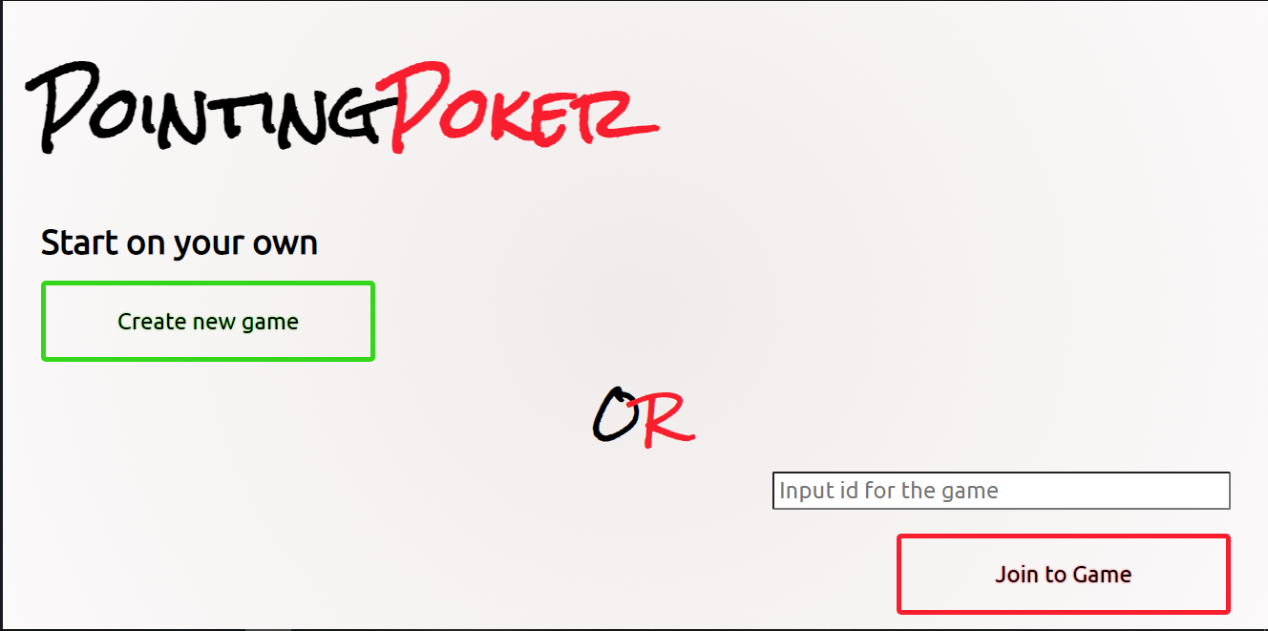
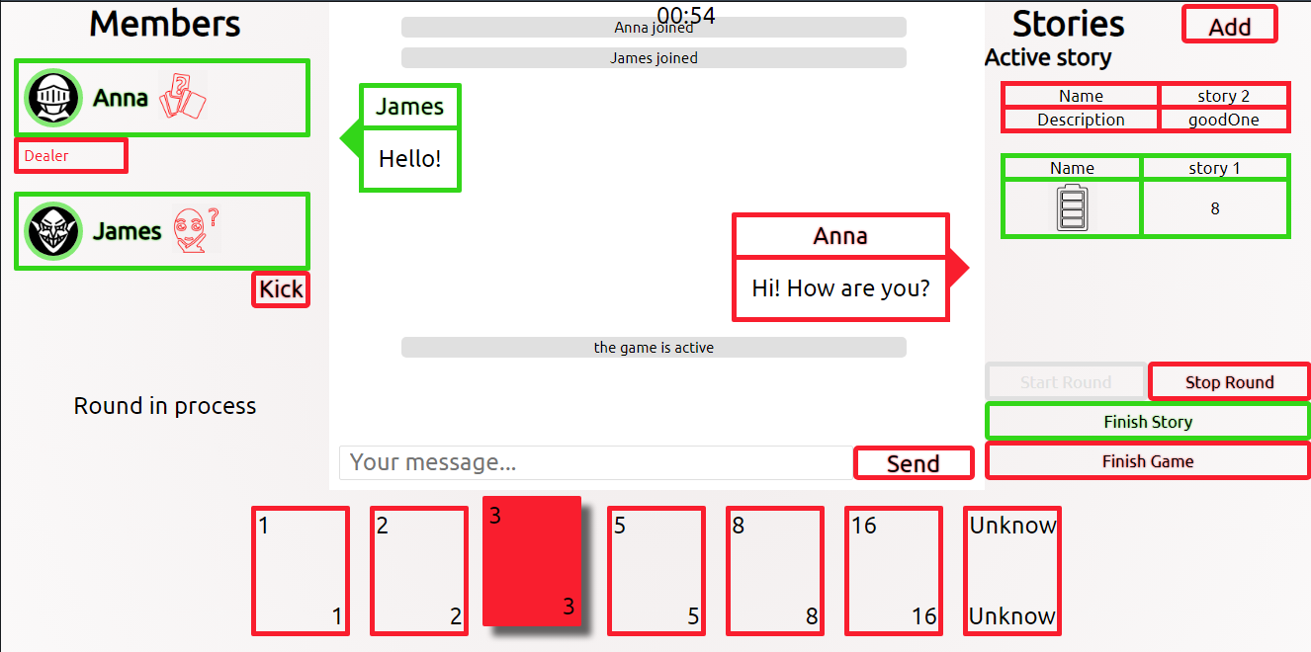
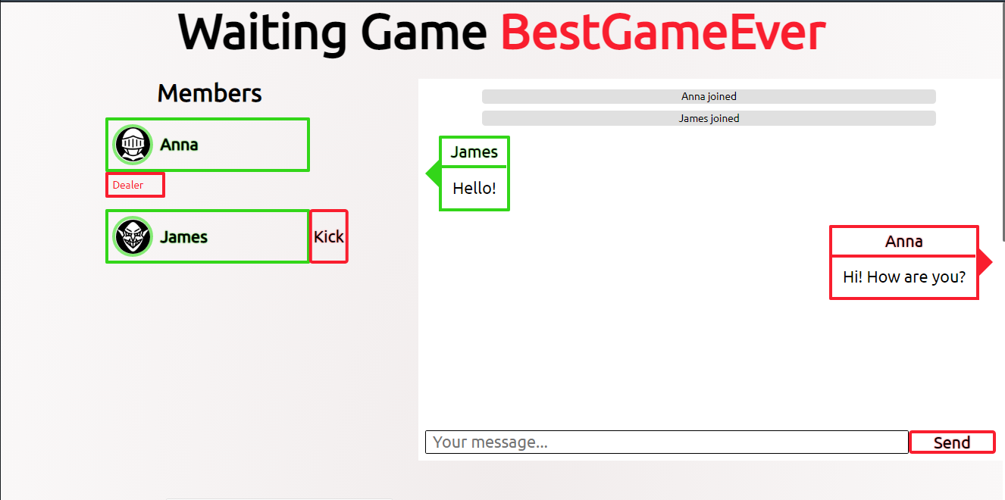
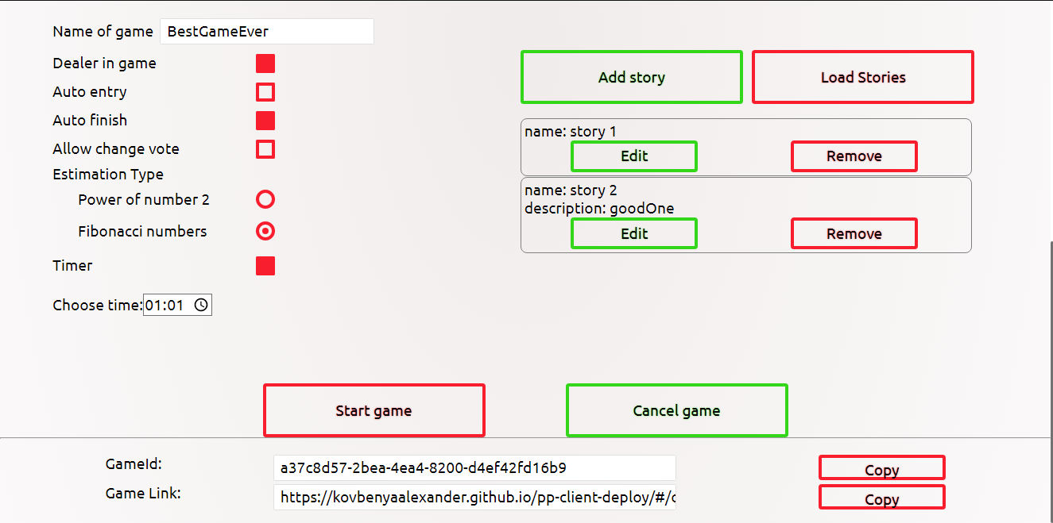
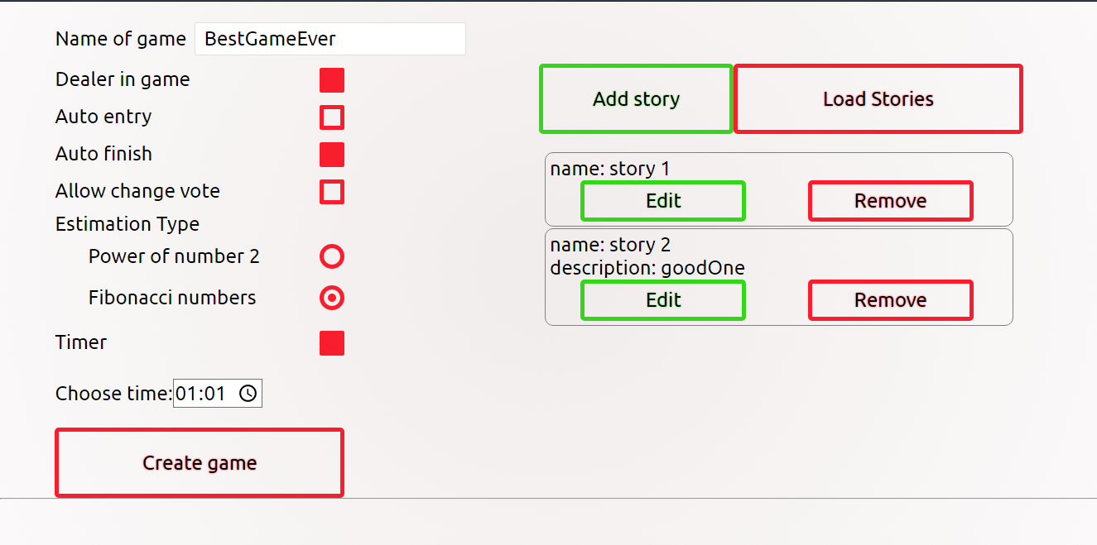
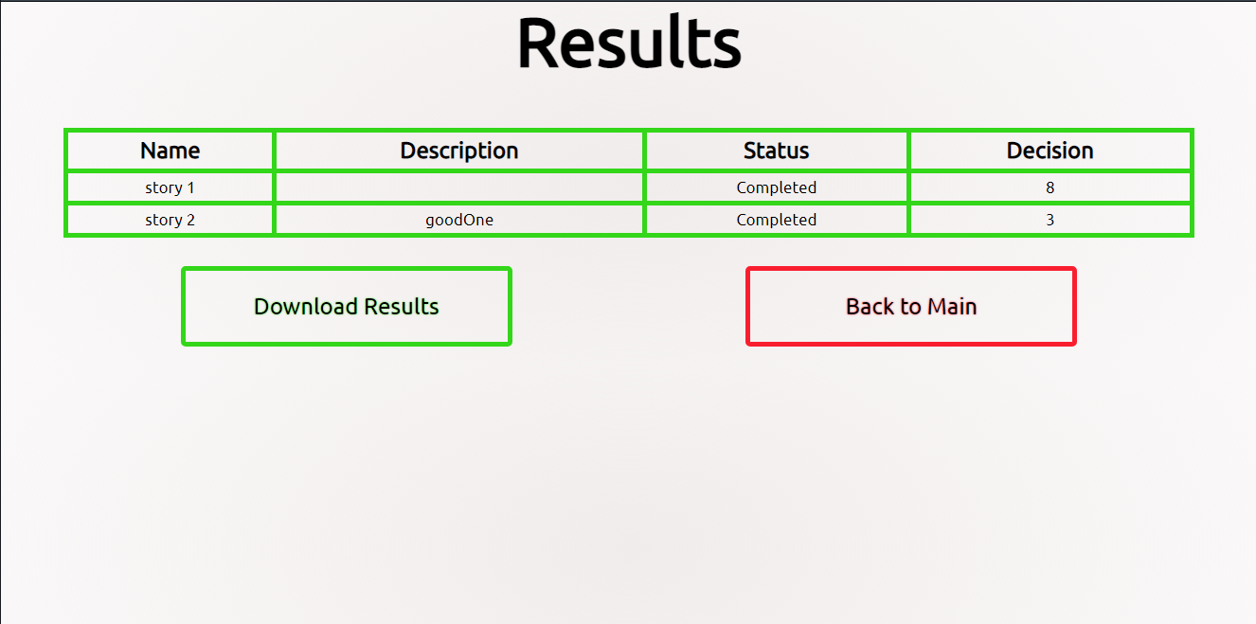
Pages
Main
Game
Lobby
Settings
Results

Slide 6
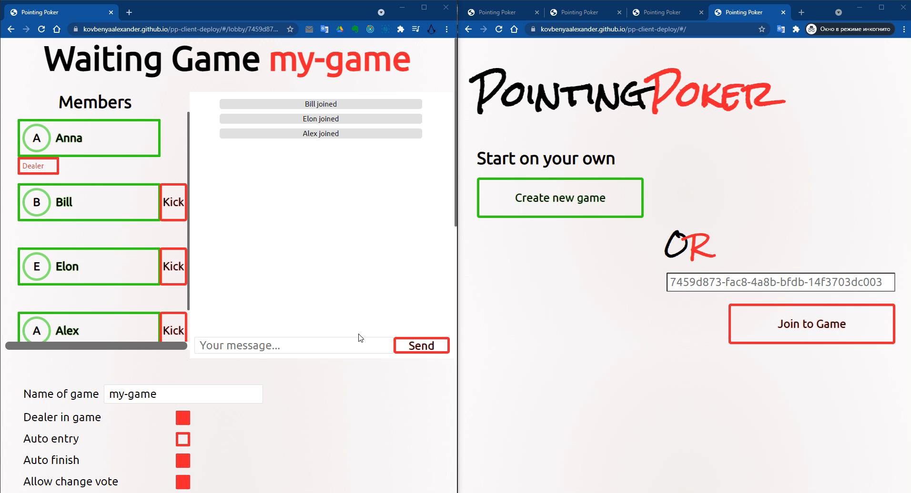
Game Process

Slide 7
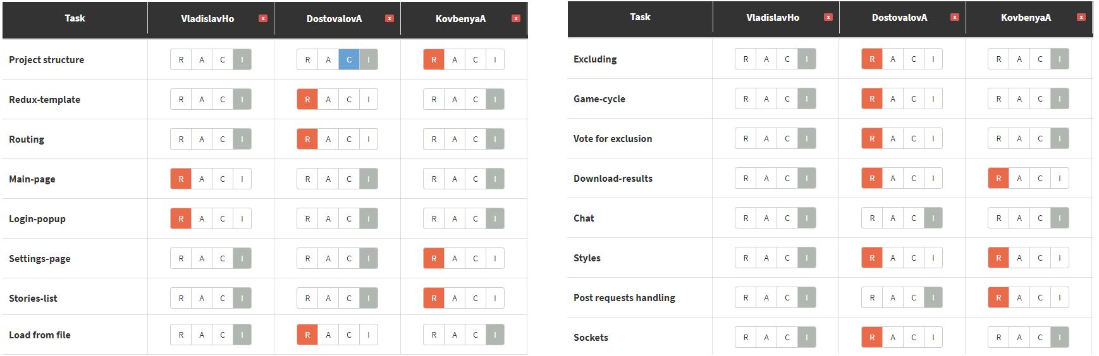
RACI-matrix

Slide 8
Conclusion
During the react-course, we created a client-server application using sockets. We have gained a lot of experience in work as a team, has some fun and, of course, has a enjoy.
Possible improvements for the app:
Add registration and authorization
Add video-chat
Store previous game’s results
Add advanced statistics
Add tests

